Slide 1


Slide 2
A Model for Early Prediction of Diabetes using ANN along with Machine Learning
:::::: Thesis Report ::::::
Department of CSE, Manarat International University
Supervised by
Sir, Sohaib Abdullah
Minhazul Zannat
ID: 1640 CSE00 466

Slide 3
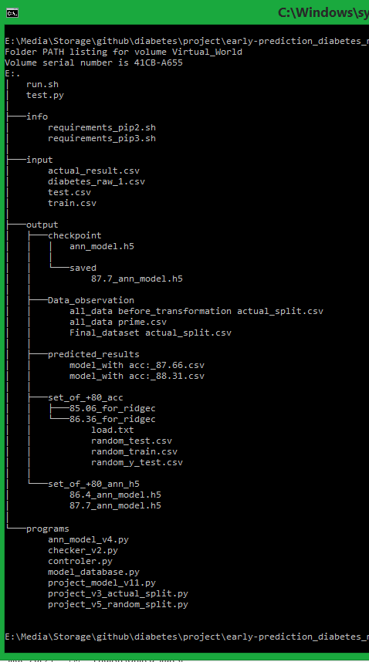
Outline
Introduction
Motion Towards The Project
Data Splitting
Data Preprocessing
Network Architecture
Training Procedure
Result
OS & Environment
Conclusion

Slide 4
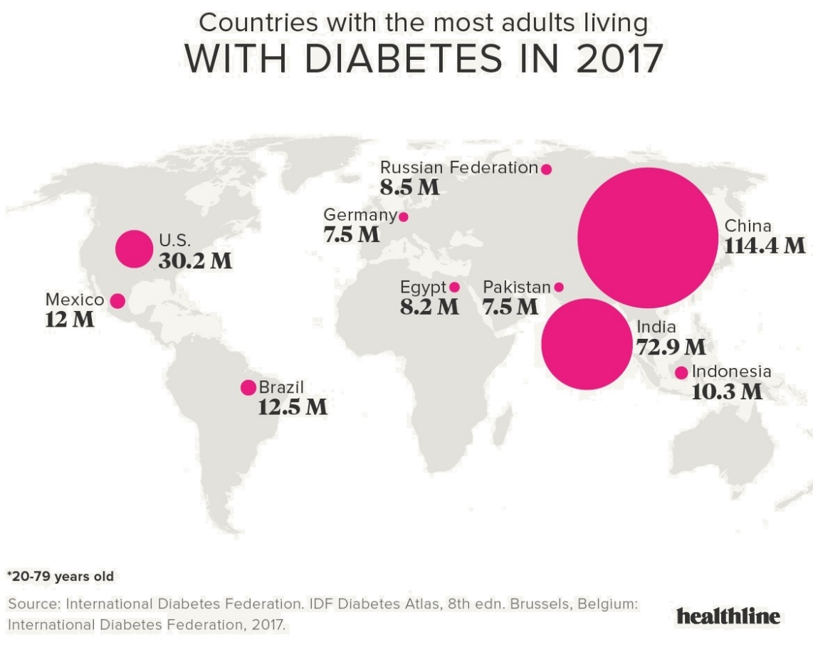
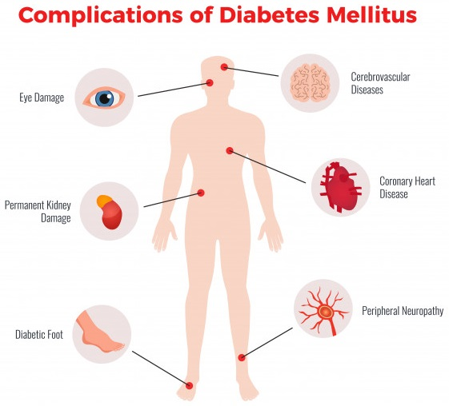
INTRODUCTION

Slide 5
DATASET OVERVIEW
National Institute of Diabetes and Digestive and Kidney Diseases (UCI ML Repository).
9 attributes, 768 records, 500 negative & 268 positive
Dataset: Pima Indian Diabetes dataset-PIDD
Sr. # | Attribute Name | Attribute Description | Types
1 | Pregnancies | Number of times | int64
2 | Glucose (mg/dl) | Oral glucose (120 min) | int64
3 | Blood Pressure (mmHg) | Diastolic | int64
4 | Skin Thickness (mm) | Fold Thickness | int64
5 | Insulin (mu U/mL) | Serum Insulin (2 h) | int64
6 | BMI (kg/m2) | Weight/(height)^2) | float64
7 | Diabetes Pedigree Function | Diabetes pedigree Function | float64
8 | Age | Years | int64
9 | Outcome | Class variable (1/0) | int64

Slide 6
MOTION TOWARDS THE PROJECT
Data Splitting
Best Case

Slide 7
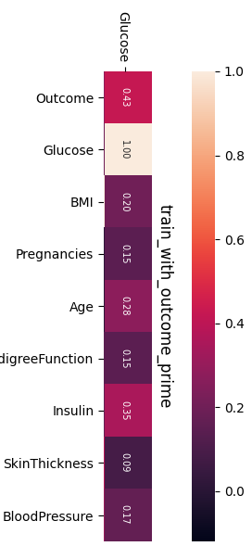
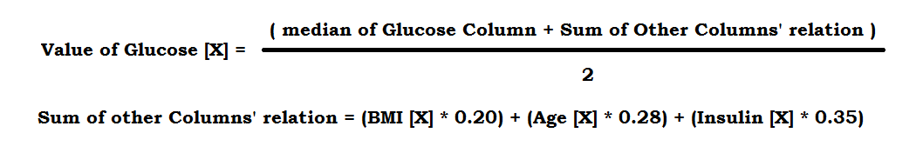
MOTION TOWARDS THE PROJECT
Data Preprocessing
Missing data handling
Glucose, Blood Pressure, Skin Thickness, Insulin, BMI
Median, values of other columns (hitmap >= 0.20)

Slide 8
Good
Better
Best

Slide 9
MOTION TOWARDS THE PROJECT
Data Preprocessing
Feature Engineering
Adding new features by creating classes.
Feature | Max, [Min] Values of Groups | New Feature’s Values
BMI | 18, 25, 30, [40] | 1, 2, 3, 4, 5
Age | 25, 38, 51, [59] | 1, 2, 3, 4, 5
Glucose | 60, 80, 140, [180] | 2, 1, 3, 4, 5
Pregnancies | 0, 3, 7, [11] | 1, 2, 3, 4, 5
Blood Pressure | 60, 75, 90, [100] | 1, 2, 3, 4, 5

Slide 10
Good
Best

Slide 11
MOTION TOWARDS THE PROJECT
Data Preprocessing
Normalization (Skewness Handling)
Multi-level transformation.
Log1p, sqrt of python’s numpy.
Robust Scaling in marching learning section.

Slide 12
MOTION TOWARDS THE PROJECT
Feature Name | Transformation(s) | Skewness
 |  | Before | After
BMI | Log 1p | 0.59 | -0.03
Glucose | Log 1p | 0.51 | -0.09
Skin Thickness | Log 1p | 1.10 | -0.38
Pregnancy Class | Log 1p | 0.60 | 0.14
Blood Pressure Class | Log 1p | 0.43 | -0.23
Age Class | Log 1p << Log 1p | 0.97 | 0.12
Age | Sqrt << Log 1p << Log 1p | 1.13 | 0.49
Insulin | Sqrt << Log 1p << Log 1p | 2.86 | 0.60
Diabetes Pedigree Function | Sqrt << Log 1p << Log 1p | 1.92 | 0.27

Slide 13
Good
Best

Slide 14
MOTION TOWARDS THE PROJECT
Network Architecture
Machine Learning (ML) approaches
Artificial Neural Network (ANN)

Slide 15
MOTION TOWARDS THE PROJECT
Machine Learning (ML) approaches
ML with RobustScaler in Pipeline:
ML approaches:
1. RidgeClassifierCV | Kfold(n_splits=10, shuffle=True), alphas
2. LogisticRegression( penalty = 'elasticnet‘) | solver = 'saga', max_iter=1e7, L1_ratio=0.05,
3. Support Vector Classifier (SVC) | C=20, gamma=0.0003,
4. GradientBoostingClassifier | learning_rate=0.01, loss='exponential'
5. LGBMClassifier | objective='binary‘, verbose=-1
6. XGBClassifier | learning_rate=0.01, seed=27,
7. LogisticRegression | 'penalty': ‘L1', 'solver': Liblinear

Slide 16
MOTION TOWARDS THE PROJECT
Machine Learning (ML) approaches
ML approaches:
8. KNeighborsClassifier | 'n_neighbors': 4, 'metric': 'minkowski', 'p':2
9. Support Vector Classifier (SVC) 2 | 'C': 1.7, 'kernel': 'rbf', 'probability':True
10. DecisionTreeClassifier | criterion: gini, max_depth:3, max_features:2
11. AdaBoostClassifier | 'learning_rate': 0.04, 'n_estimators': 150
12. GradientBoostingClassifier | 'learning_rate': 0.01, 'n_estimators': 100
13. GaussianNB (Naive Bayes)
14. RandomForestClassifier | 'n_estimators': 15, 'criterion': 'gini'
15. StackingCVClassifier | Classifiers = MLs’, meta_classifier=xgboostc

Slide 17
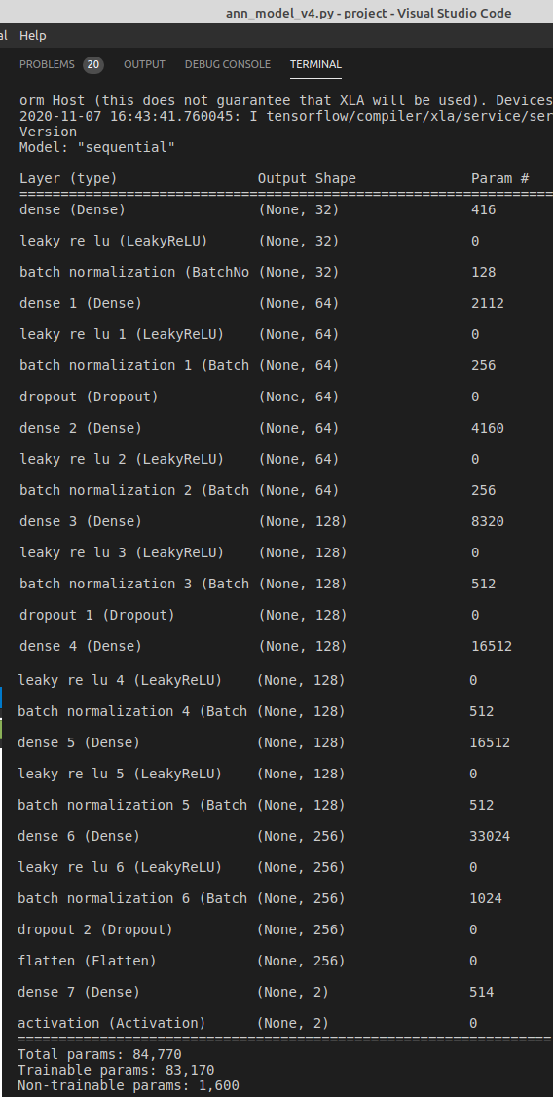
MOTION TOWARDS THE PROJECT
Network Architecture
Artificial Neural Network
Sequential architecture
7 + 1 dense, 7 + 1 activation, 7 batchNormalization, 3 dropout layers.
Initial weight = 0.01
Random split of 80% train is 85/15 of 100% (85% train, 15% test for ANN)
Relu, LeakyReLU (alpha=0.01) activation functions. LeakyReLU for best case.
[32, 64, 64, 128, 128, 128, 256] dense layers from top to down for best case.
[0.10, 0.15, 0.20] dropout layers from top to down for best case.
Max Epochs = 900, get best result at 300
[ 87.66 % accuracy for 20% test set]

Slide 18
1 |  |  |  | 2 |  |  |  |  | 3
Dense | Activation | Batch Normalization |  | Dense | Activation | Batch Normalization | Dropout |  | Dense | Activation | Batch Normalization
32 | LeakyReLU |  |  | 64 | LeakyReLU |  | 0.10 |  | 64 | LeakyReLU
4 |  |  |  |  | 5 |  |  |  | 6
Dense | Activation | Batch Normalization | Dropout |  | Dense | Activation | Batch Normalization |  | Dense | Activation | Batch Normalization
128 | LeakyReLU |  | 0.15 |  | 128 | LeakyReLU |  |  | 128 | LeakyReLU
7 |  |  |  |  | 8
Dense | Activation | Batch Normalization | Dropout |  | Flatten | Activation | Batch Normalization
256 | LeakyReLU |  | 0.20 |  |  | softmax
Figure: ANN model architecture of 87.66% accuracy

Slide 19
MOTION TOWARDS THE PROJECT
Network Architecture
ModelCheckpoint
EarlyStopping
Reduce Learning Rate on Plateau
monitor = ‘val_loss’
factor = 0.2
patience = 5
min_lr = 0.001

Slide 20
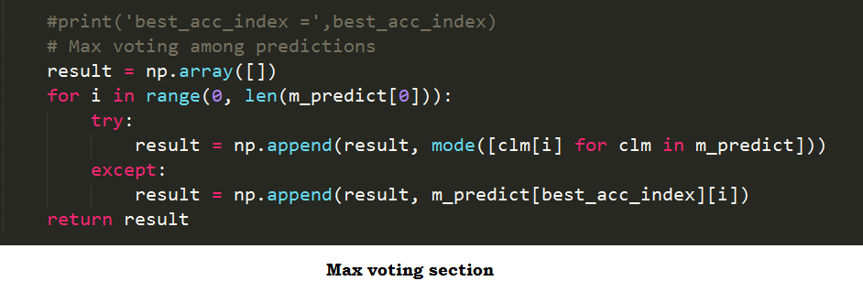
MOTION TOWARDS THE PROJECT
Training Procedure
Merge models (Max Voting)
Merged our models using max voting.
Where default model is the best accuracy giver (ANN)
[ 88.31 % -- Accuracy ]

Slide 21
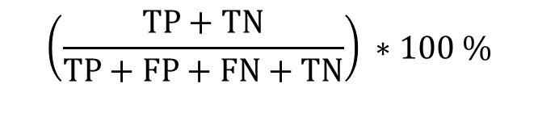
MOTION TOWARDS THE PROJECT
Training Procedure
Calculating Accuracy
Confusion matrix
Accuracy =
 |  | Actual
 |  | Positive | Negative
Predicted | Positive | True Positive (TP) | False Positive (FP)
 | Negative | False Negative (FN) | True Negative (TN)
$$\left(\frac{TP+TN}{TP+FP+FN+TN}\right) ∗100 \%$$

Slide 22
Result
All Models’ Accuracy
Best Models’ Accuracy

Slide 23
Comparison with Other Projects
Author: T.M. Ahmed
Paper: Using data mining to develop model for classifying diabetic patient control level based on historical medical records.
Accuracy calculation: Confusion Matrix
Used Approaches: Logistic Reg., Naive Bayes, Decision tree(J48)
74.60%
Author: Amina Azrar, Muhammad Awais, Yasir Ali
75.65%
Paper: Data Mining Models Comparison for Diabetes Prediction
Accuracy calculation: Confusion Matrix
Used Approaches: Naive Bayes, KNN, Decision Tree
Author: Talha Mahboob Alama, Muhammad Atif Iqbala, Yasir Alia,
75.70%
Paper: A model for early prediction of diabetes
Accuracy calculation: Confusion Matrix
Used Approaches: ANN, Random Forest, K-means
Author: Deepti Sisodia, Dilip Singh Sisodiab
76.30%
Paper: Prediction of Diabetes using Classification Algorithms.
Accuracy calculation: Confusion Matrix
Used Approaches: Decision Tree, SVM, Naive Bayes

Slide 24
Comparison with Other Projects
Author: T.M. Ahmed
Dataset: Health Facts database (Cerner Corporation, Kansas City)
Data Preprocessing:
Using WEKA software (University of Waikato)
Feature Engineering:
New features: 2 classes
Author: Amina Azrar, Muhammad Awais, Dataset: Pima Indian Diabetes dataset-PIDD
Data Preprocessing:
Missing data handling: mean, mode
Data mining: integration, normalization
Feature Engineering:
New features: 2 classes
Author: Talha Mahboob Alama, Muhammad Atif Iqbala, Yasir Alia,
Dataset: Pima Indian Diabetes dataset-PIDD
Data Preprocessing:
Missing data handling: median
Data mining: normalization
Feature Engineering:
New features: 5 classes

Slide 25
Comparison with Other Projects
Author: Deepti Sisodia, Dilip Singh Sisodiab
Dataset: Pima Indian Diabetes dataset-PIDD
Data Preprocessing:
Using WEKA software (University of Waikato)
Feature Engineering:
None
Author: MZ Minhaz
Dataset: Pima Indian Diabetes dataset-PIDD

Slide 26
Operating System & Environment
Project was run in one laptop only.
PC model: Acer Aspire V3-572P
OS (Dual boot): Windows_8.1 & Linux Mint_19.3 (Tricia)
Ram size: 6GB
====================================================================
System Type: 64-bit both OS, x64-bit based Processor
Linux Terminal: GNOME - 3.28.1, VTE 0.52.2 +GNUTLS-PCRE2
P. Language: Python - 3.6.3 (Using both virtualenv & Direct environment in Linux)
Text Editor: Sublime-text-3 (In Win8.1) & VS-code (In Linux)

Slide 27
Conclusion
Some challenging situations we have faced on running those models :
Using larger network layers in ANN reduces the speed of training with a big rate.
Using higher layers gives better result, though makes higher ram use.
Algorithm choosing in M.L. takes a lot of effort than N.N.
Our contribution in this project which are not taken before in this study:
We present with the approach of combining neural network & machine learning.
We introduce with a random split approach for neural network at training stage.
We introduce a new technique to find best set of train and test (Random split)
We try to introduce with new techniques of data preprocessing (Hitmap relation)
We try to introduce with model combining on max voting.

Slide 28
Limitation and Future work
Limitations:
To run with higher epochs & dense size, it requests high configure environment.
Our dataset is not as big as expectation for neural network.
We have short time on researching with the models.
Lack of the knowledge of parameter choosing.
Future work:
Implement more neural network approaches in it (Like: googlenet, resnet).
Implement this architecture in large dataset to achieve better performance.
Implement it in practical field through web & institutions to find real world performance.
GitHub Link of this project:
https://github.com/mzminhaz5683/early-prediction_of_diabetes_using_ann_and_machine_learning
Email: mz.minhaz5683@gmail.com

Slide 29
Questions ?

